Slide 1

The Cortana Intelligence Suite
Foundations – Evaluating the Model
Microsoft Machine Learning and Data Science Team
CortanaIntelligence.com
Notes:
Main page: http://cortanaanalytics.com
To begin this module, you should have:
Basic Math and Stats skills
Business and Domain Awareness
General Computing Background
NOTE: These workbooks contain many resources to lead you through the course, and provide a rich set of references that you can use to learn much more about these topics. If the links do not resolve properly, type the link address in manually in your web browser. If the links have changed or been removed, simply enter the title of the link in a web search engine to find the new location or a corollary reference.

Slide 2

Section 5 Learning Objectives
Understand how to evaluate the efficacy and performance of an Azure ML experiment
Understand how to evaluate the efficacy and performance of an MSR ML experiment
Access and show data from Azure Storage
Access and Query Azure SQL DB
Notes:
At the end of this Module, you will:
Understand how to evaluate the efficacy and performance of an Azure ML experiment
Understand how to evaluate the efficacy and performance of an MSR ML experiment
Access and show data from Azure Storage
Access and Query Azure SQL DB

Slide 3
The Data Science Process and Platform

Slide 4
The Team Data Science Process
Business Understanding
Define Objectives
Identify Data Sources
Data Acquisition and Understanding
Ingest Data
Explore Data
Modeling
Feature Selection
Create and Train Model
Deployment
Customer Acceptance
Operationalize
Testing and Validation
Update Data
Handoff
Re-train and re-score
Notes:
This process largely follows the CRISP-DM model: http://www.sv-europe.com/crisp-dm-methodology/
It also references the Cortana Intelligence process: https://azure.microsoft.com/en-us/documentation/articles/data-science-process-overview/
A complete process diagram is here: https://azure.microsoft.com/en-us/documentation/learning-paths/cortana-analytics-process/
Some walkthrough’s of the various services: https://azure.microsoft.com/en-us/documentation/articles/data-science-process-walkthroughs/
An integrated process and toolset allows for a more close-to-intent deployment
Iterations are required to close in on the solution – but are harder tio management and monitor
Data Science Blog: https://buckwoody.wordpress.com/

Slide 5
The Cortana Intelligence Platform
Cortana, Cognitive Services, Bot Framework
Power BI
HDInsight
Stream Analytics
Azure Machine Learning (MRS)
SQL Data Warehouse (SQL DB, Document DB)
Data Lake
Event Hubs
Data Factory
Data Catalog
Microsoft Azure
Notes:
Platform and Storage: Microsoft Azure – http://microsoftazure.com Storage: https://azure.microsoft.com/en-us/documentation/services/storage/ (Host It)
Azure Data Catalog: http://azure.microsoft.com/en-us/services/data-catalog (Doc It)
Azure Data Factory: http://azure.microsoft.com/en-us/services/data-factory/ (Move It)
Azure Event Hubs: http://azure.microsoft.com/en-us/services/event-hubs/ (Bring It)
Azure Data Lake: http://azure.microsoft.com/en-us/campaigns/data-lake/ (Store It)
Azure DocumentDB: https://azure.microsoft.com/en-us/services/documentdb/ , Azure SQL Data Warehouse: http://azure.microsoft.com/en-us/services/sql-data-warehouse/ (Relate It)
Azure Machine Learning: http://azure.microsoft.com/en-us/services/machine-learning/ (Learn It)
Azure HDInsight: http://azure.microsoft.com/en-us/services/hdinsight/ (Scale It)
Azure Stream Analytics: http://azure.microsoft.com/en-us/services/stream-analytics/ (Stream It)
Power BI: https://powerbi.microsoft.com/ (See It)
Cortana: http://blogs.windows.com/buildingapps/2014/09/23/cortana-integration-and-speech-recognition-new-code-samples/ and https://blogs.windows.com/buildingapps/2015/08/25/using-cortana-to-interact-with-your-customers-10-by-10/ and https://developer.microsoft.com/en-us/Cortana (Say It)
Cognitive Services: https://www.microsoft.com/cognitive-services
Bot Framework: https://dev.botframework.com/
All of the components within the suite: https://www.microsoft.com/en-us/server-cloud/cortana-intelligence-suite/what-is-cortana-intelligence.aspx
What can I do with it? https://gallery.cortanaintelligence.com/
Getting Started Quickly: https://caqs.azure.net/#gallery

Slide 6
Module 1: Measuring Effectiveness and Efficiency in ML
Notes:
Train and Evaluate your Model: https://azure.microsoft.com/en-us/documentation/articles/machine-learning-walkthrough-4-train-and-evaluate-models/

Slide 7
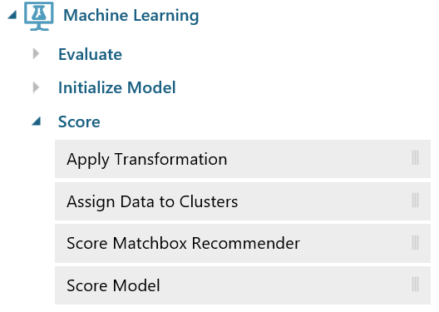
Azure Machine Learning
Score
Apply a trained model to:
A list of recommended items
Forecasts for time series models
Estimates of projected demand, volume, or other numeric quantity, for regression models
Cluster assignments
A predicted class or outcome, for classification models
Probability scores associated with these outputs
Notes:
https://azure.microsoft.com/en-us/documentation/articles/machine-learning-algorithm-choice/
https://msdn.microsoft.com/en-US/library/azure/dn906012.aspx
https://msdn.microsoft.com/en-us/library/azure/dn913055.aspx
https://msdn.microsoft.com/en-us/library/azure/dn913055.aspx
https://msdn.microsoft.com/en-us/library/azure/dn905970.aspx
https://msdn.microsoft.com/en-us/library/azure/dn905995.aspx

Slide 8
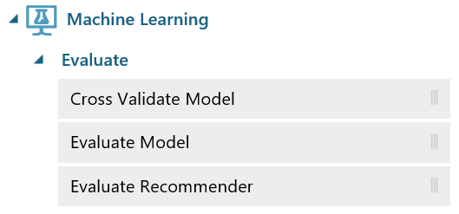
Azure Machine Learning
Evaluate
Metrics for Classification Models
Accuracy, Recall, Precision, F1-Score
AUC
Average Log Loss
Training Log Loss
Metrics for Regression Models
Mean absolute error (MAE)
Root mean squared error (RMSE)
Relative absolute error (RAE)
Relative squared error (RSE)
Coefficient of determination
Notes:
Simple explanation of the ROC Curve: http://blog.revolutionanalytics.com/2016/08/roc-curves-in-two-lines-of-code.html
https://msdn.microsoft.com/en-us/library/azure/dn906026.aspx
https://azure.microsoft.com/en-us/documentation/articles/machine-learning-evaluate-model-performance/
https://msdn.microsoft.com/library/azure/75fb875d-6b86-4d46-8bcc-74261ade5826
https://msdn.microsoft.com/library/azure/927d65ac-3b50-4694-9903-20f6c1672089
https://msdn.microsoft.com/library/azure/e9ad68a7-e91b-4ae6-800e-b5ee7e22cd17

Slide 9
Module 2: Accessing result data from Azure Storage
Notes:
Working with Azure Storage: https://azure.microsoft.com/en-us/documentation/services/storage/

Slide 10
Options for Data Access
Power BI / Excel
Query Tools
Code
3rd Party
Notes:
Access and read through this page: https://support.office.com/en-us/article/Connect-to-Microsoft-Azure-Blob-Storage-Power-Query-f8165faa-4589-47b1-86b6-7015b330d13e?ui=en-US&rs=en-US&ad=US&fromAR=1
Access and read through this page: http://social.technet.microsoft.com/wiki/contents/articles/2128.azure-and-sql-database-tutorials-tutorial-1-using-azure-web-role-and-azure-table-service.aspx
Data Science Blog: https://buckwoody.wordpress.com/

Slide 11



Lab:
Connecting to an Azure SQL Database
Notes:
Optional: On your DVSM, you can connect to Azure SQL DB after you open the firewall.
Read this for creating a database server and database: https://azure.microsoft.com/en-us/documentation/articles/sql-database-get-started/
In the portal, find and record your connection strings: http://www.connectionstrings.com/sql-azure/
Read this to connect and browse to a database: https://msdn.microsoft.com/en-us/library/hh272693%28v=vs.103%29.aspx

Slide 12
Module 3: Accessing Data from API-based Sources
Notes:
Accessing storage using Code: https://azure.microsoft.com/en-us/documentation/articles/storage-dotnet-how-to-use-blobs/ - other SDKs are listed for various tasks on Azure (including Azure Storage: https://azure.github.io/projects/sdks/

Slide 13
Options for Data Sourcing
API Sources
Storage Sources
Coding access (REST)
Notes:
REST Documentation: https://msdn.microsoft.com/en-us/library/azure/dd179355.aspx
Data Science Blog: https://buckwoody.wordpress.com/

Slide 14
Understand how to evaluate the efficacy and performance of an Azure ML experiment
Understand how to evaluate the efficacy and performance of an MSR ML experiment
Access and show data from Azure Storage
Access and Query Azure SQL DB
Notes:
Questions?

